Slide 1
ENROLLMENT
2021
FALL GENERAL FACULTY
ENROLLMENT UPDATE
Dr. Don Hunt
Senior Vice Provost Enrollment Management and Services
EXECUTIVE SUMMARY
2025 ENROLLMENT GOALS
FALL 2021 UPDATES
STUDENT SUCCESS
WRAP UP AND QUESTIONS

Slide 2
EXECUTIVE
SUMMARY

Slide 3
EXECUTIVE SUMMARY
Meeting 2025 Enrollment Goals
Fall 2021 Updates
Working Towards Student Success
Retention Rates
Graduation Rates
Wrap Up and Questions

Slide 4
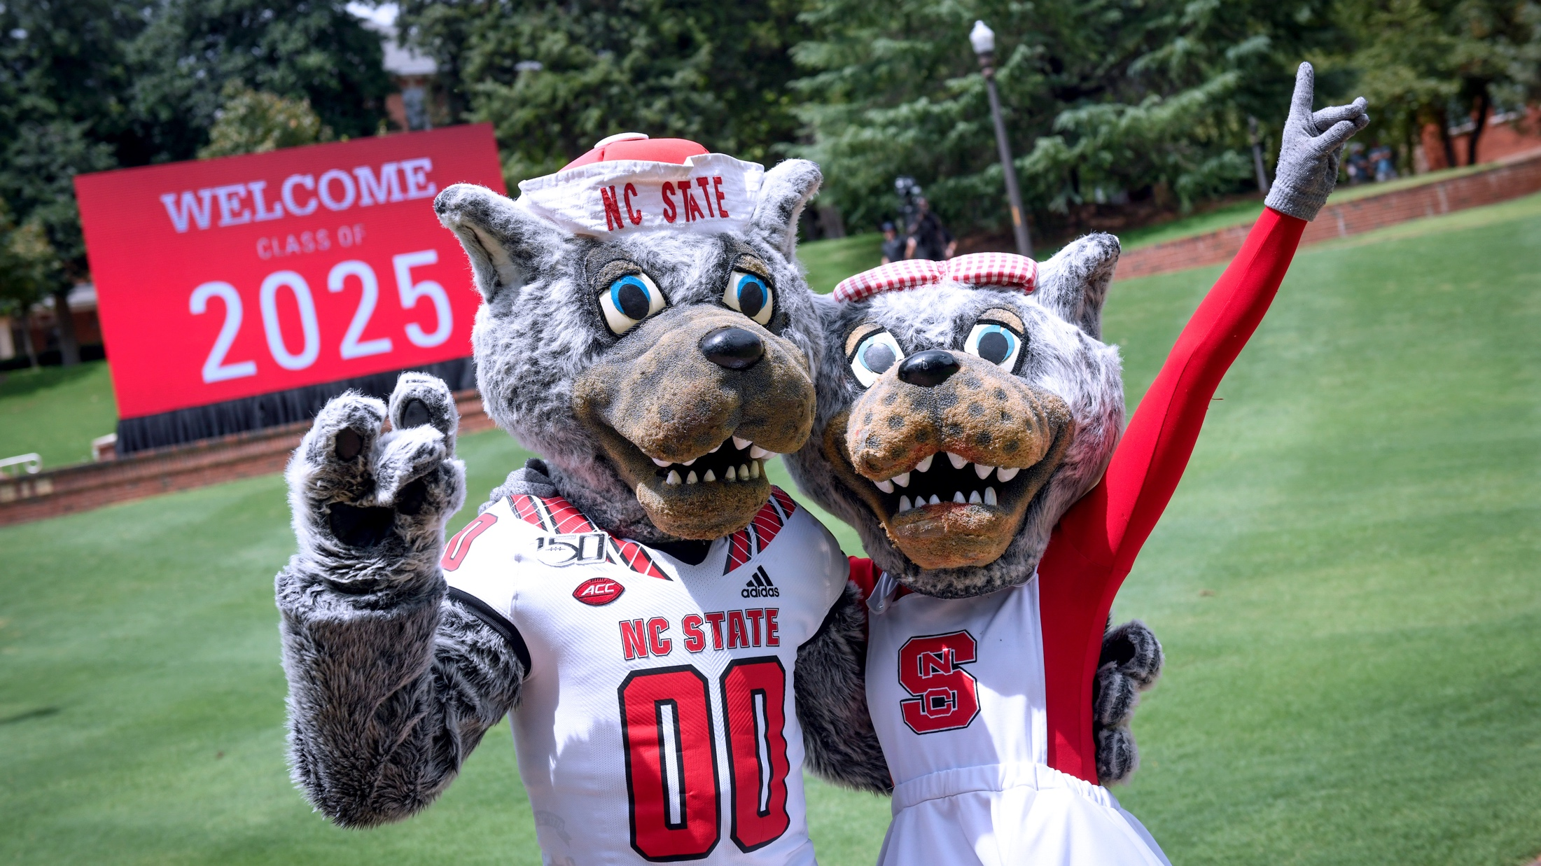
MEETING 2025
Enrollment GOALS

Slide 5
2025 ENROLLMENT GOALS
2015 Baseline
2021 Current
2025 Target
% to Target
Total Undergraduate (Bachelors)
22,131
24,960
24,720
+1.0%
Total Ag Institute
330
229
355
35.5%
Total Master’s
5,316
5,776
6,695
13.7%
Total Doctoral
3,361
3,619
4,230
14.4%
Total DVM
396
397
400
0.8%
Total Degree Seeking
31,534
34,981
36,400
3.9%
Certificates in Colleges
282
506
625
19.0%
Total Non-Degree Seeking
2,199
2,069
1,675
+23.5%
GRAND TOTAL
34,015
37,556
38,700
3.0%
Source: data.emas.ncsu.edu as of Aug 30th, 2021

Slide 6
FALL 2021
UPDATES

Slide 7
FALL 2021 ENROLLMENT TRENDS
37,556
Total Enrollment
3.0% increase
Total Undergraduate Enrollment*
26,908
*(includes Undergraduate, Agricultural Institute, and Non-Degree)
2.7% increase
Total Graduate Enrollment*
10,648
*(includes Doctoral, Master’s, graduate certificates, Post- Baccalaureate Non-Degree)
3.7% increase
Source: data.emas.ncsu.edu as of Aug 30th, 2021

Slide 8
FALL 2021 ENROLLMENT TRENDS
276,974
Hybrid
57,119
Hybrid
Online
Online
Total Undergraduate
In-Person Total Credit Hours
Total Graduate
In-Person Total Credit Hours
In Person
In Person
86.3% In Person (Fall 2019)
Undergraduate Credit Hours
81.3% In Person (Fall 2019)
Graduate Credit Hours
Source: data.emas.ncsu.edu as of Aug 30th, 2021

Slide 9
FALL 2021 NEW UNDERGRAD TRENDS
37,025
Total Applications
Incoming Undergraduate students are majority female and
more diverse
4.6% increase
17,561
Total Admitted
4.5% increase
Increases in Hispanic (19%), Black or African American (8%) and underrepresented minorities (10%)
6,373
Total Accepted
4.3% increase
Source: data.emas.ncsu.edu as of Aug 30th, 2021
Includes Freshman and Transfer Undergraduates Only

Slide 10
FALL 2021 NEW UNDERGRAD TRENDS
Out-of-State
Increased incoming Undergraduate enrollment from Tier 1 and 2 counties*
International
Percentage of Tier 1 increased by 19%
Percentage of Tier 2 increased by 14%
In-State
The 40 most distressed counties are designated as Tier 1, the next 40 as Tier 2.
Percent of Incoming Students By Residency
*County Tiers are calculated using four factors: Average unemployment rate, Median household income, Percentage growth in population, and Adjusted property tax base per capita
Source: data.emas.ncsu.edu as of Aug 30th, 2021
Includes Freshman and Transfer Undergraduates Only

Slide 11
INCOMING FIRST YEAR
32,907
75%
29.6
Total Applications
Top 20% of HS Class
Average ACT (Opted-In Test Scores Only
15,602
45%
1354
Total Admitted
Top 10% of HS Class
Average SAT (Opted-In Test Scores Only)
4,982
4.31
3.83
Total Accepted
Average GPA (weighted)
Average GPA (unweighted)
Source: data.emas.ncsu.edu as of Aug 30th, 2021

Slide 12
INCOMING FIRST YEAR
Source: data.emas.ncsu.edu as of Aug 30th, 2021

Slide 13
INCOMING TRANSFERS
4,118
59%
1 in 5
Total Applications
Students from NC Community Colleges
Students Transfer From Another UNC Institution
1,959
80
26
Total Admitted
Total NC Counties Represented
Total States Represented
1,391
3.48
45
Total Accepted
Transfer GPA
Average Overall
Credits Transferred (major requirements, GEP requirements, electives, and non degree)
Source: data.emas.ncsu.edu as of Aug 30th, 2021

Slide 14
INCOMING TRANSFERS
Source: data.emas.ncsu.edu as of Aug 30th, 2021

Slide 15
STUDENT
SUCCESS

Slide 16
STUDENT SUPPORT PROGRAMS
Goodnight Scholars Program
Community College Collaboration
Pre-College Programs
Provost’s Professional Experience Program
Student Services Center
Veterans Education Benefits
Summer START
Academic Success Center
Career Development Center
Disability Resources Office
Military Veteran Services
TRIO Programs

Slide 17
RETENTION RATES
Retention rates for all incoming undergrads students:
Retention rates remain steady
1 Year
2 Year
3 Year
92.8%
89.2%
87.1%
Fall 2016
93.0%
89.0%
87.2%
Fall 2017
Fall 2018
93.4%
89.7%
87.7%
Fall 2019
93.2%
89.6%
Fall 2020
93.5%
Source: data.emas.ncsu.edu as of Aug 30th, 2021
Includes Freshman and Transfer Undergraduates Only

Slide 18
GRADUATION RATES
Graduation rates increased for all incoming undergrads students by:
Graduation rates increased
4 Year
5 Year
6 Year
62.2%
80.1%
82.5%
Fall 2013
62.7%
81.1%
83.7%
Fall 2014
Fall 2015
67.1%
82.7%
84.6%
Fall 2016
68.3%
83.5%
Fall 2017
70.1%
Source: data.emas.ncsu.edu as of Aug 30th, 2021
Includes Freshman and Transfer Undergraduates Only

Slide 19
WRAP UP

Slide 20
WRAP UP
Increases in overall enrollment
79.26% of undergraduate courses are offered in-person
Increases in new student enrollment
Diversity increases (Hispanic and Black or African American)
Tier 1 and Tier 2 increases
Student support to drive success
Increases in overall graduation rates

Slide 21
QUESTIONS

