Slide 1
SEA Change
STEMM Equity Achievement
A comprehensive initiative from the American Association for the Advancement of Science (AAAS)
https://seachange.aaas.org/
Sheri L. Schwab, Vice Provost for Institutional Equity and Diversity

Slide 2
What is SEA Change?
A proven self-assessment process to effect sustainable, positive change for DEI in STEMM at U.S. institutions of higher education
NC State joined in 2020 as the third charter member
NC State participates in collaborative idea-sharing sessions with this cohort of 17+ institutions

Slide 3
The Three Pillars of SEA Change
Institute
Centralized repository for resources and educational opportunities related to DEI in STEMM and higher education
Community
Opportunities for members to share and discuss strategies for enhancing DEI in STEMM
Awards
Members may apply for awards that recognize commitment to sustainable systemic change re DEI in STEMM

Slide 4
Bronze Award
Applications include:
An in-depth, data-rich self-assessment of institutional makeup, policies, hiring and career transitions, culture & climate;
Identification of “data gaps” and plans to collect missing information in the future;
Identification of significant issues & barriers related to DEI;
A SMART action plan.
Award based on:
“Commitment and action to assess and remove structural and systemic barriers to the inclusion of all individuals of talent, which enhances quality of learning and work and supports STEM excellence.”

Slide 5
NC State’s Aims for Participating
Conduct a comprehensive and thoughtfully-designed self-assessment that can be used as a benchmarking tool for periodic analysis;
Identify short- and long-term goals that will assist in sustainable and systemic progress toward a more diverse, equitable and inclusive NC State;
Implement an accountability structure, buttressed by SEA Change’s peer review process, to strengthen NC State’s efforts;
Deepen understanding of the need for DEI in achieving innovation from an academic lens;
Increase recruitment, retention and climate for faculty, staff and students in STEMM (and throughout the university).

Slide 6
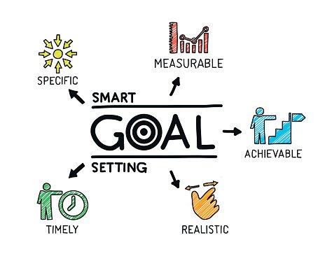
Next Steps
NC State has assembled its Self Assessment Team
Team will engage in assessment and goal-setting Dec 21 – Apr 22
Website to help communicate progress (coming soon)
Plan to submit application for Bronze Award in April 2022

Slide 7
For more information
Sheri L. Schwab
Vice Provost for Institutional Equity and Diversity
slschwab@ncsu.edu
919.515.4559

