Slide 1
Supporting Affordability and Equity in Course Materials
David Tully
Sheariah Stevens
Will Cross

Slide 2
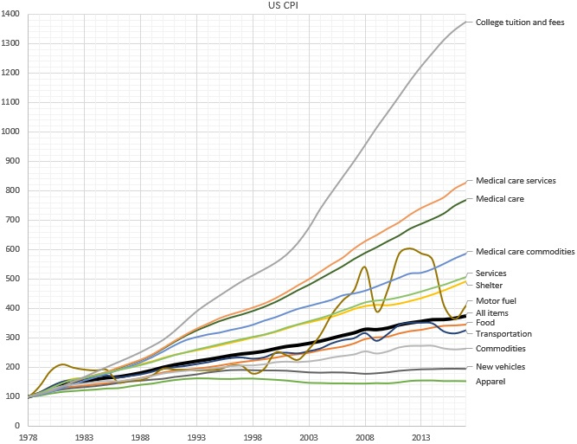
Bureau of Labor Statistics http://www.bls.gov/cpi/
Notes:
Background - rising cost of tuition, mounting debt

Slide 3
https://studentservices.ncsu.edu/your-money/financial-aid/estimated-cost-of-attendance/undergraduate-student/

Slide 4
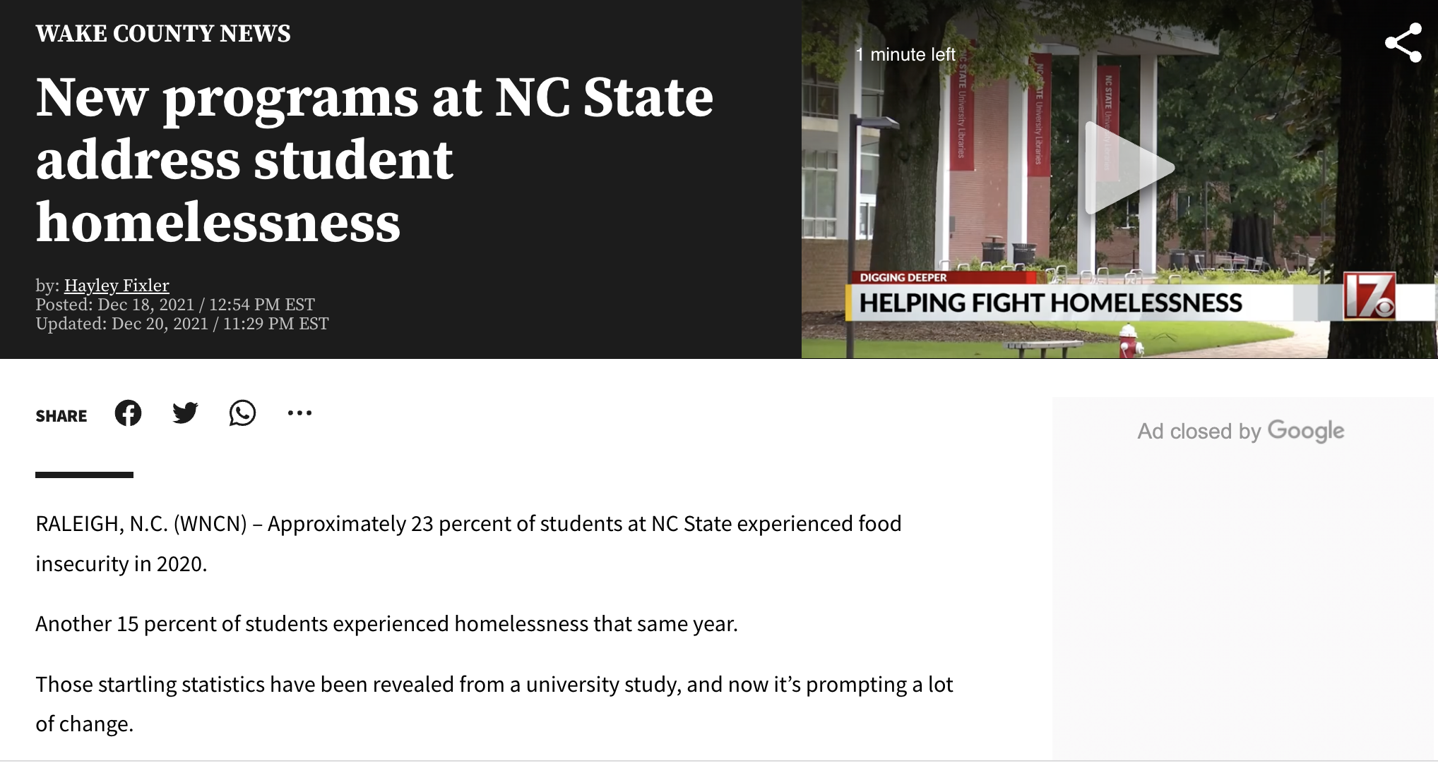

Slide 5
The Impact of Textbook Cost
2018 “Student Textbook and Course Materials Survey,” Florida Virtual Campus, 2018

Slide 6
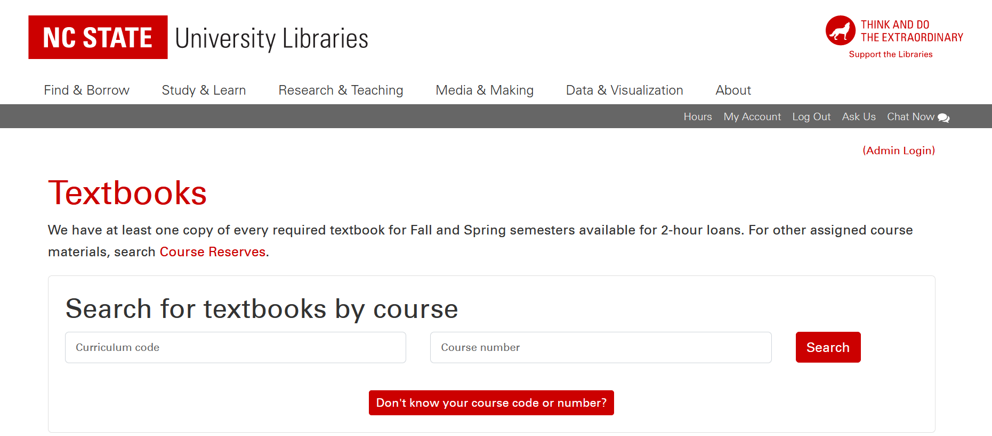
What We Do
https://textbooks.lib.ncsu.edu/

Slide 7
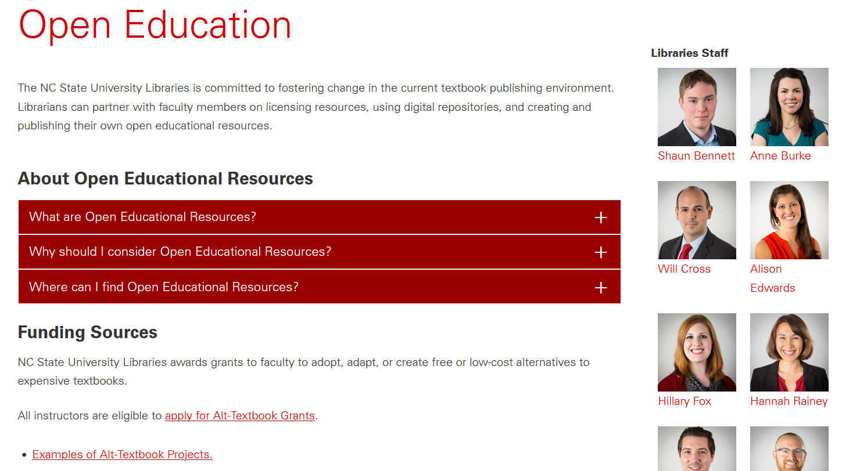
What We Do
https://www.lib.ncsu.edu/alttextbook

Slide 8
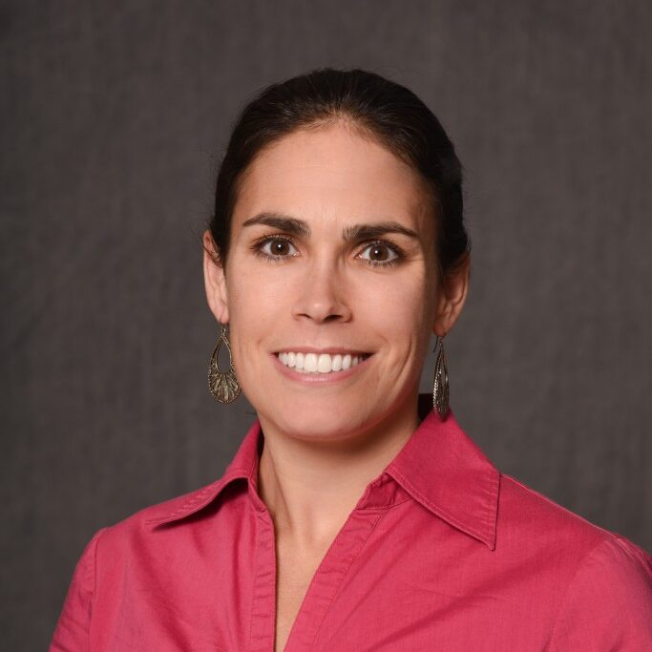
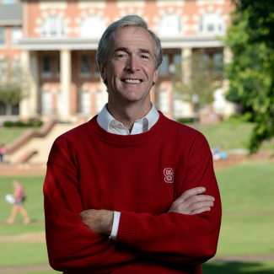
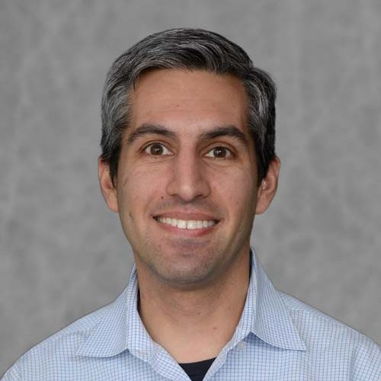
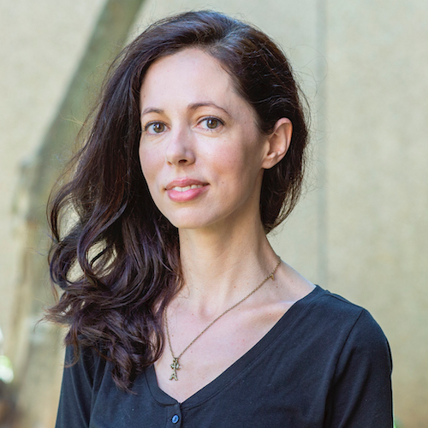
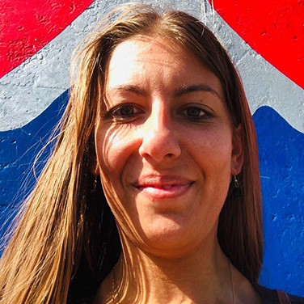
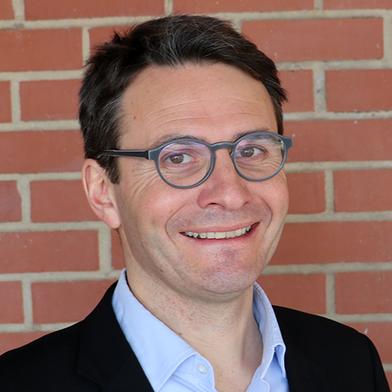
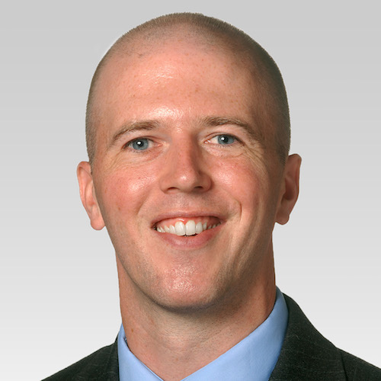
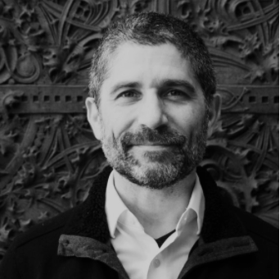
Alt-Textbook Awards for 2021-22: $75,432 per semester
Renee Harrington
Health & Exercise Studies
Jeffery Braden
Psychology
Carlos Goller
Biological Sciences
Bevin Maultsby
Mathematics
Arianna Soldati
Marine, Earth & Atmospheric
François Birgand
Biological & Agricultural Engineering
Thayer Morrill
Management
Marc Russo
Art+Design

Slide 9
What You Can Do
Tell your students and include the Libraries as a resource in your syllabi
Tell the Bookstore what textbooks you’re using
Check out the Open Pedagogy Incubator
Review an Open Textbook ($200 grant support)
Adapt/Adopt/Create an Open Textbook ($2,500 grant support)
Partner with other faculty on a group project ($2,500 per participant grant support)

Slide 10
Review slides and discover more information: go.ncsu.edu/alt_textbook
David Tully
dtully@ncsu.edu
Sheariah Stevens svsteven@ncsu.edu
Will Cross
wmcross@ncsu.edu
Unless otherwise marked, all images are used under fair use as described
in the Code of Best Practice in Fair Use for OER

