Slide 1
Faculty Senate
Assessment & Accreditation
Updates
January 23, 2024
Notes:
FC

Slide 2
SACSCOC 2024 Reaffirmation
Compliance Certification (self-study) submitted September 2023
Off-site reviewer feedback/requests for focused reports November 2023
Focused reports and QEP due February 9, 2023
Preparation for on-site visit March 25-28, 2024
Off-campus Instructional Site visits February 21-22 and March 25, 2024

Slide 3
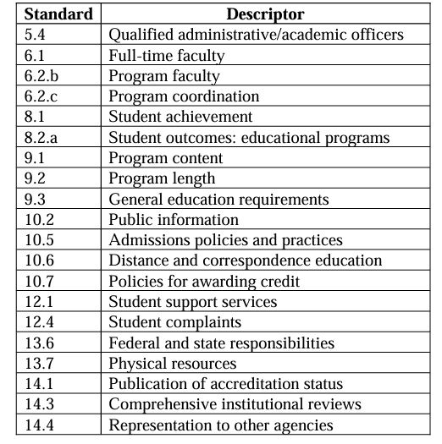
On-site Meetings: 20 of the 40 Standards

Slide 4
Focused Reports
4.2g - Board Self-evaluation (on-going)
Board of Trustees and Board of Governors
6.2a - Faculty Qualifications
6.2b - Program Faculty
10.6 - Distance and Correspondence Education
Student Identity and FERPA compliance regarding Proctors
13.2 - Financial Documents
Annual Institutional Audit

Slide 5
Faculty Standards: 6.2A
Out of 3,175 instructors 101 were flagged.
We need to write a justification for each instructor.
Collect CVs, Syllabi and Transcripts for each instructor.
On-site committee will request to meet with Provost, Deans and Dept. Heads during March visit.
Notes:
alternate credentials, hiring, evaluations, qualifications

Slide 6
6.2b: Program Faculty
Sufficient number of full-time faculty (FT) at the program-level.
SACSCOC threshold: FT faculty deliver 55-60% of the student credit hours (SCHs).
13 programs fell below the SACSCOC threshold.
Justification regarding sufficiency

Slide 7
QEP Updates
Quality Enhancement Plan (QEP)
Title: Packways: Learning By Doing
Focus: High Impact Experiences (HIEs), Experiential Learning
Dr. Holly Hurlburt is Interim QEP Director
Final QEP submitted by February 9, 2024
Hire QEP Director (Search Spring 2024)

Slide 8
NC House Bill 8
UNC System institutions will change accreditors after every reaffirmation cycle
With SACSCOC since 1928
Florida and North Carolina

Slide 9
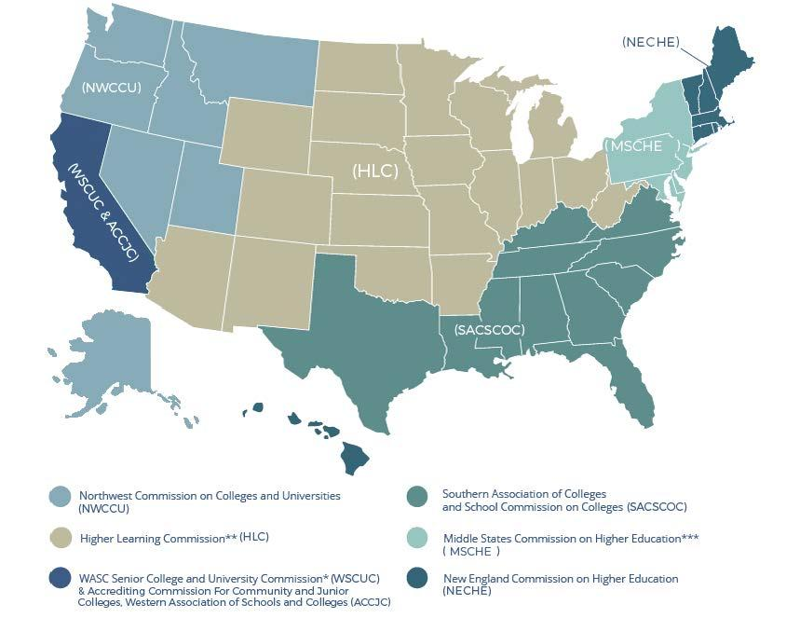

Slide 10
Draft: Timeline
Reaffirmation (2014)
Fifth-Year Review (2020)
Reaffirmation (2024)
Fifth-Year Review (AY 2028)
QEP Impact Report
Reaffirmation (2034)
Application to change (2028ish)
New Accreditor (around 2030)

Slide 11
Conclusion
Questions?
Thank you!

