Slide 3
Notes:
Chart illustrates Student Athlete and Undergrads cum GPAs since Fall 2019.
Each term, we hover around 50 student-athletes earning term GPAs of 4.0, so Fall 2024 was particularly strong.
374 of our 503 student-athletes had a 3.0 or higher, which is 74% of student-athletes
(no cum 3.0: Baseball, Football, Men’s Soccer)

Slide 4
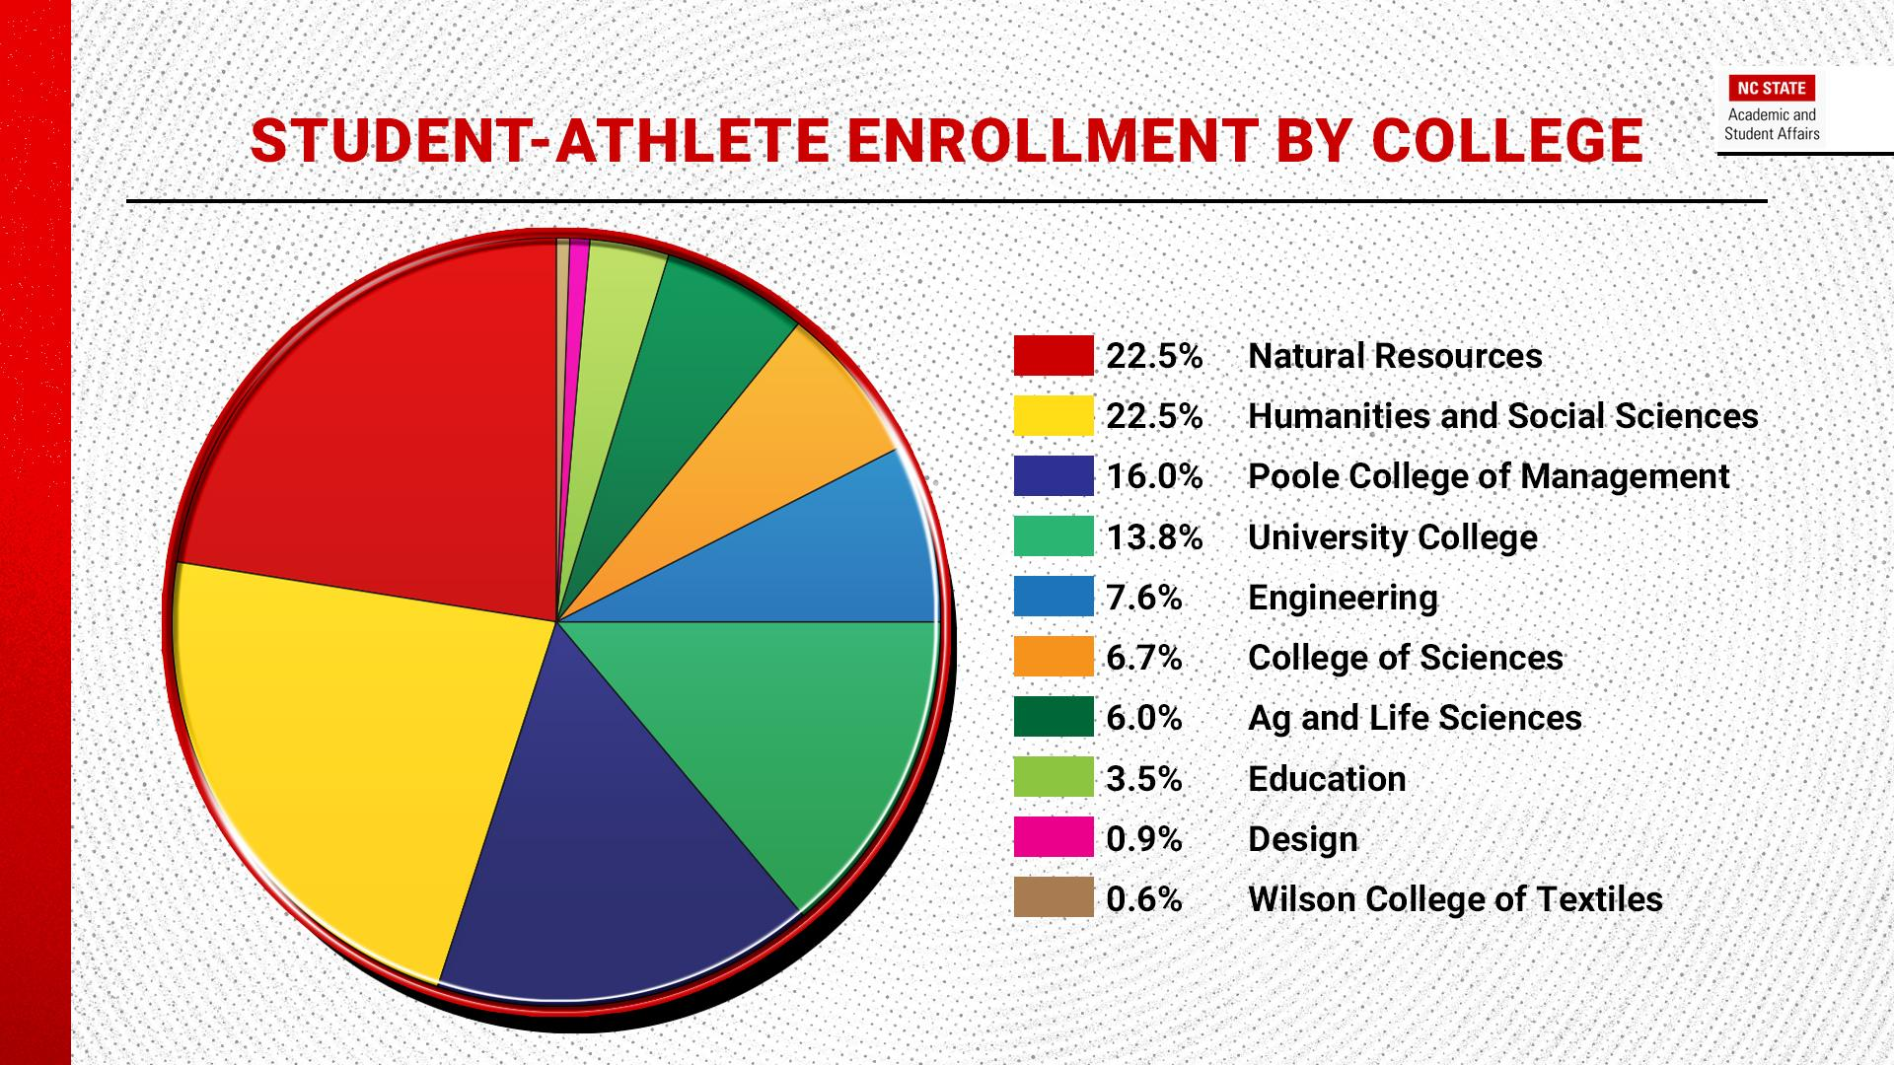
Notes:
Student-athletes enrolled in each of our colleges
Chart depicts the distribution of student athletes across the colleges
Each year when we take a look at this data, Poole College, Humanities and Social Sciences, and Natural Resources have the greatest percentage of our student-athlete enrollment.
Natural Resources -104
Hum and Social Science - 104
Poole Col of Management - 74
Univ College - 64
Engineering - 35
Col of Sciences - 31
Ag and Life Sciences - 28
Education - 16
Design - 4
WIlson Col of Textiles - 3

Slide 5
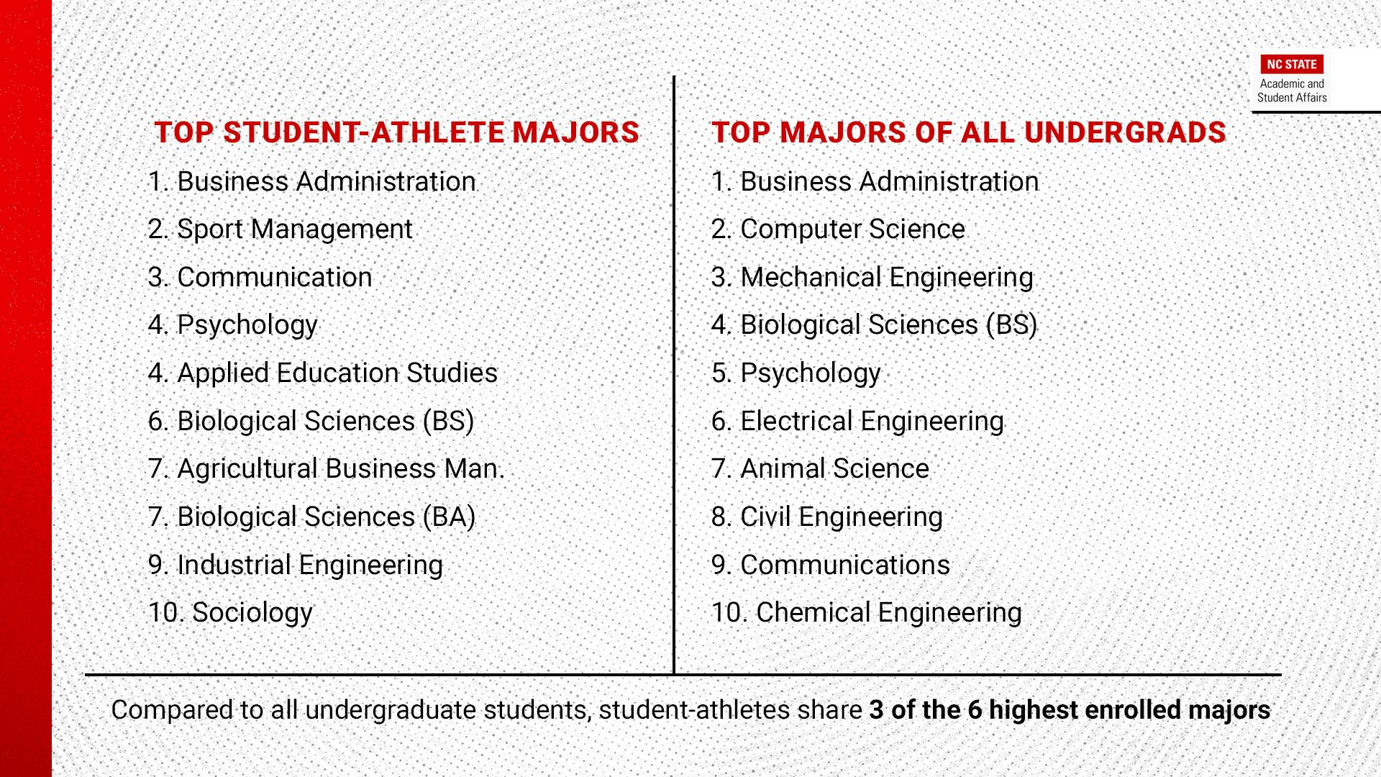
Notes:
Further breakdown here by major. Previous slide was all student-athletes, this slide is a smaller population of just juniors and higher because that should give a sense of the major the students will actually graduation from (after declaring or changing in their first couple of years).
MBB - Communication and Sport Management (8 total)
MFB - Sport Management, Communications, Business Administration (24 total)
WBB - Business Admin and Communication, but a lot of variety on that roster 12 SAs in 9 different programs!

Slide 7
Notes:
GSR National Average 91%
Student-athletes who persist at NC State graduate at a 92%
Years included: 2014-15, 2015-16, 2016-17, 2017-18
The projected 93% will be finalized/released next October, 2025.

