Slide 1
Athletics Update to Faculty Senate April 2025
Joel J. Pawlak, Associate Professor and Faculty Athletics Representative
Boo Corrigan, Director of Athletics
Katie Graham, Assistant Vice Chancellor and Senior Associate Athletics Director

Slide 2
Overview
Council on Athletics – Pawlak
The Team Behind the Team
Changes in Athletics
Athletics Update – Corrigan
Academics Update – Graham

Slide 3
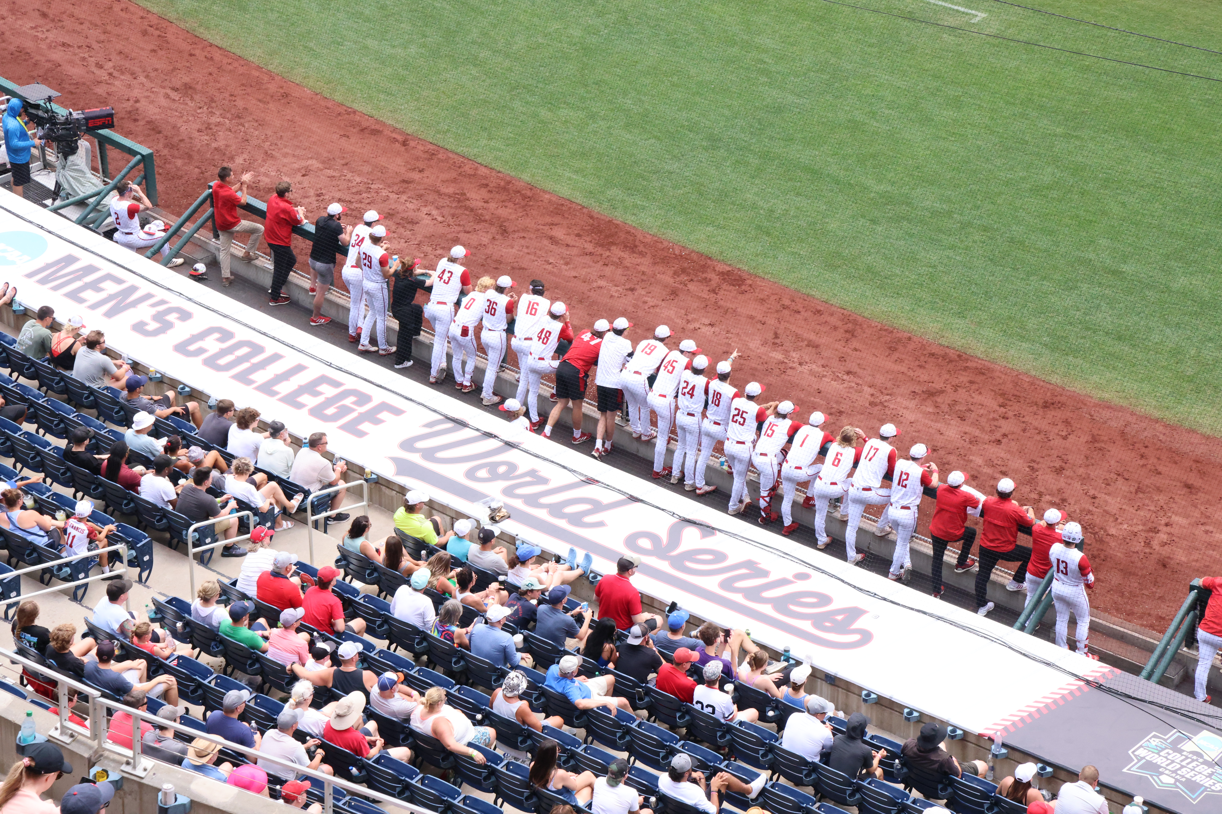
Council on Athletics
Purpose and Responsibility
Assist the Chancellor in exercising institutional control.
Membership (26) composed of Faculty, Alumni Association, Wolfpack Club, Coaching Staff, Students, Athletics Department Staff (ex officio).

Slide 4
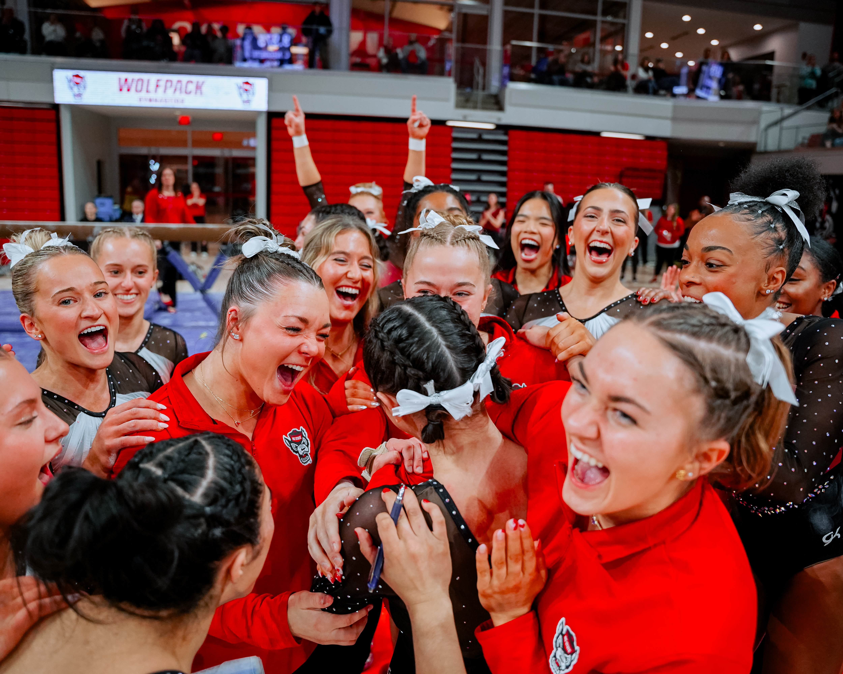
Council Theme The Team Behind the Team
Goal: To take a deeper dive into the various support services provided to student-athletes.
Meeting Agenda Items:
Athletics Communications
Sports Nutrition
Sports Psychology

Slide 5
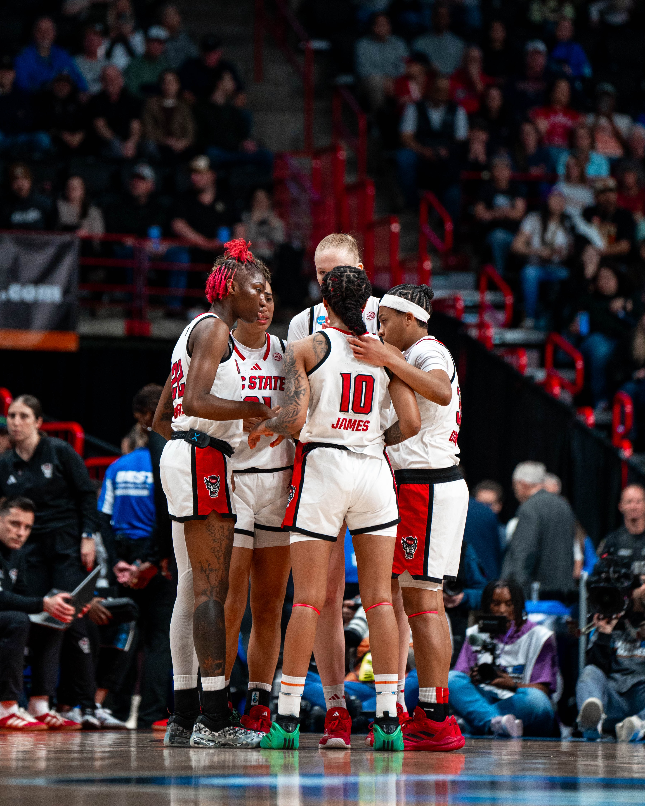
Areas of Discussed on an Annual Basis
Academic performance and graduation rates
Budget
Title IX
Changes in NCAA rules
Meetings with head coaches
Facilities upgrades and improvements

Slide 6
ACC Expansion
Table of competition days out of Eastern Time Zone
15 to 18 teams
Addition of…
Strengthens the position of the conference.
Provides opportunity for Stanford and Cal to remain in a power conference.
*ACC Expansion

Slide 7
Legal Challenges Facing College Athletics (Presented to Faculty Senate April 2024)
NIL Related Case – “House Case”
Seeking to void old NIL legislation and damages, broadcast NIL, including 10 % of television revenue for football and basketball.
Academic Awards – “Hubbard Case”
Seeking damages for those who would have qualified for the academic incentive money now being awarded (up to $5980 per year).
Labor and Employment Status – “Johnson Case,” NLRB, Dartmouth Basketball
Seeking payment for practice and competition, status as employees, ability to unionize.
Dartmouth Basketball Team succeeded in their case and have since voted to unionize.
Preliminary Injunctions allow:
Unlimited transfers with immediate eligibility.
Student-athletes to negotiate NIL deals before signing with a school.
Florida State and Clemson suits against the ACC.
Others.
Potential Damages could
be more than $5 billion.

Slide 8
House Case Proposed Settlement
Four major elements:
Settlement of back damages to class members for $2.75 billion paid over ten years.
Establishment of revenue sharing between institutions and student-athletes. ($20.5 million)
Elimination of scholarship limits and addition of roster limits.
Creation of a clearinghouse for NIL deals over $600 to be fair market value.
Timing:
Final settlement approval – Last hearing was April 7, 2025
New rules proposed to take effect July 1, 2025 (pending approval)

Slide 9
FAR Summary
Council is active and engaged throughout the academic year with the oversight of Athletics, with numerous conversations related to changes in college sports.
The Council has maintained a positive working relationship with the Athletics Department.
As changes take place, the Council intends to provide oversight, including increased travel demands and the well-being of our student-athletes.

